Slide 1
Distinguishing Helpful User Reviews
An NLP classification analysis of book reviews by Andrew Dettor

Slide 2
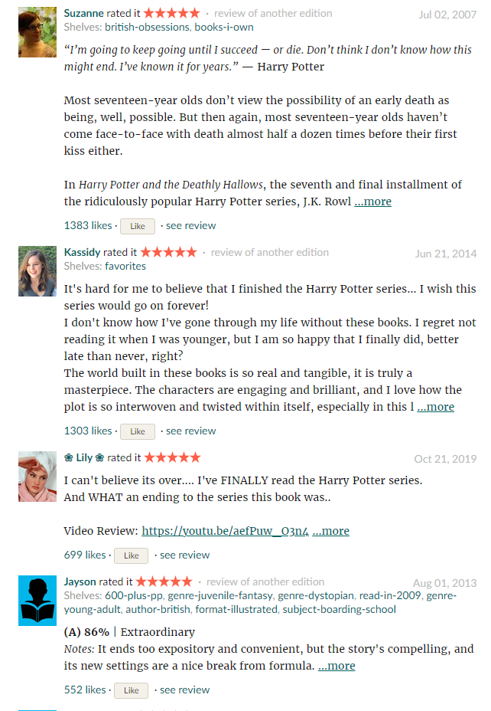
Why?
Save time
Books especially
Find what they want
More informative
Notes:
Photo Citation: Harry Potter and the Deathly Hallows. Retrieved December 12, 2021 from https://www.goodreads.com/book/show/136251.Harry_Potter_and_the_Deathly_Hallows.
Why do helpful reviews matter?
Save time
Movies
~1.5 hours
Books especially
30+ hours?
Find what they want
Review can let reader know if it’s their type of book
If the reader finds a book they really like they’ll rate the book higher
They’ll also probably use the site more
More informative
Goes beyond what the description says
Really good reviews should just become the description

Slide 3
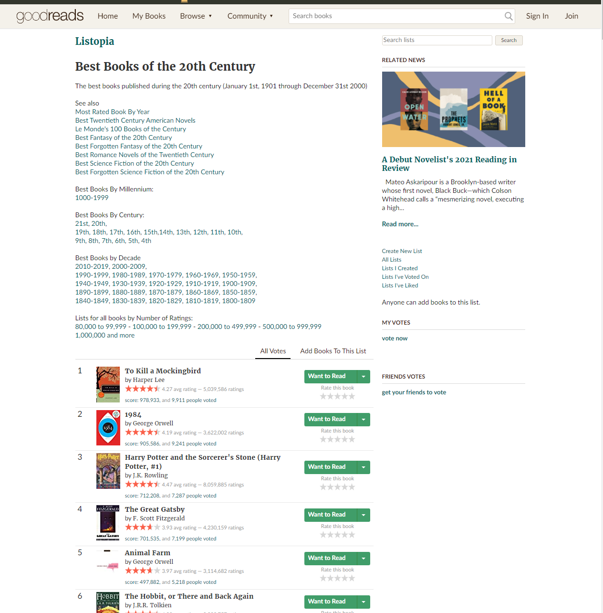
Data Collection
Goodreads.com
Lists
Pages
Books
Reviews
html parsing
Source: [20]
Notes:
Photo Citation: Best Books of the 20th Century (7566 books). Retrieved December 12, 2021 from https://www.goodreads.com/list/show/6.Best_Books_of_the_20th_Century
Goodreads.com
Has community curated lists
Lists
Each list can have thousands of books
Lists are split into pages
Pages
100 books per page
Books
30 reviews on the first page of reviews for each book
Reviews
Review text
Number of likes
html parsing
Python web scraping
BeautifulSoup4 and requests
Went from list->page->book->review with code
Used 6 lists which were sorted by average book rating
Worst books, best books, books in between
Looked at 5 pages per list
Around 3000 books total
Around 90000 reviews total
Didn’t actually get those numbers but got close

Slide 4
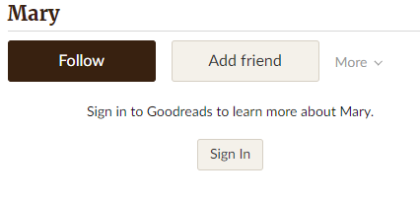
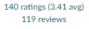
What makes reviews helpful?
Reviewer expertise
Timeliness of review
Linguistic features
Subjectivity
Writing style
Sources: [9, 17, 5, 13, 12]
Sources: [9, 17, 5, 13, 12, 20]
Notes:
Photo Citation:
Mary. Goodreads. Retrieved December 12, 2021 from https://www.goodreads.com/user/show/96888-mary
Reviewer expertise
More trusted
More articulate
Better communicator
Timeliness of review
Soon after the book came out
It’s trending
Linguistic features
Subjectivity
Writing style
Many ways to find out these features

Slide 5
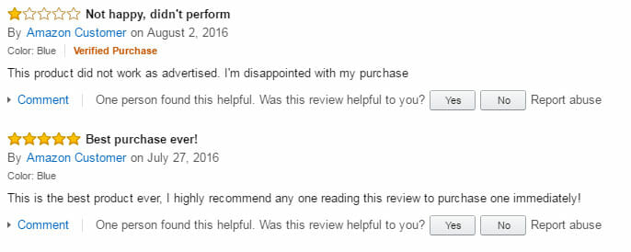
Defining helpfulness
“X out of Y reviewers liked this review”
Proportion [14, 15, 5]
Not anymore?
Classification
“Natural” cutoff [14]
Empirical [5]
Regression [15, 5]
Goodreads
discretization
Notes:
Photo Citation: Recent Updates to Amazon Verified Purchase Reviews. Retrieved December 12, 2021 from https://www.marketplacesellercourses.com/recent-updates-to-amazon-verified-purchase-reviews/
“X out of Y reviewers liked this review”
Proportion [14, 15, 5]
Each review’s helpfulness score is the proportion of likes to dislikes
Not anymore?
Amazon now just shows total likes
Goodreads only shows total likes
Classification
“Natural” cutoff [14]
Looked at distribution
0.5
Empirical [5]
Looked at error rate
0.6
Regression [15, 5]
Just use the proportion as a score, do away with helpful/not helpful
Goodreads
Each review’s “score” is the number of likes it got divided by the total number of likes on reviews on the page
Discretization
Go from continuous to discrete
Learned a little about this in class…

Slide 6
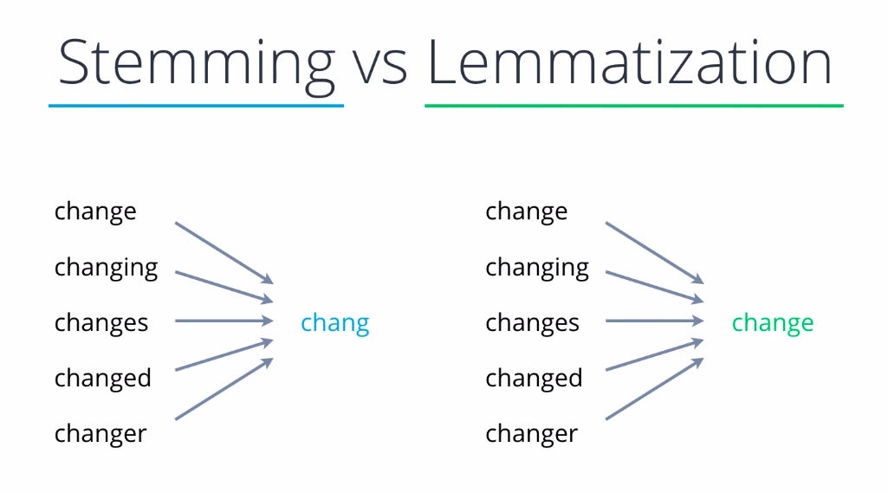
Traditional NLP Methods
Preprocessing
Lemmatization, stemming, word segmentation, part of speech tagging, tokenization, etc [4, 15, 2, 9, 1]
Lexicon
LDA [6, 15]
Involved [8]
Expert knowledge [8]
Notes:
Photo Citation: Prateek Sawhney. 2021. Introduction to Stemming and Lemmatization (NLP). Geek Culture. Retrieved December 12, 2021 from https://medium.com/geekculture/introduction-to-stemming-and-lemmatization-nlp-3b7617d84e65
Preprocessing
Lemmatization, stemming, word segmentation, part of speech tagging, tokenization, etc [4, 15, 2, 9, 1]
Basically reengineering english so a computer can understand it
Lexicon
The vocabulary
Has polarities of words
LDA [6, 15]
Unsupervised
Cannot pronounce
Involved [8]
Many different steps
How do you know what steps are best?
Expert knowledge [8]
Many features use expert knowledge
Readability
Subjectivity
Need an expert to judge those type of things
Or judge how to automate judging those things

Slide 7
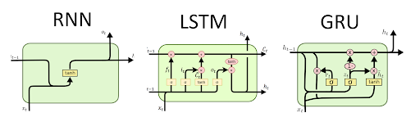
Using Deep Learning
Feature engineering [8]
Good performance [3, 2, 7, 11, 14]
Only text [14]
Other features [2]
CNN, LSTM, GRU [7, 2, 14, 11]
Poor interpretability
Notes:
Photo Citation: RNN, LSTM & GRU. http://dprogrammer.org/. Retrieved from http://dprogrammer.org/rnn-lstm-gru
Feature engineering [8]
Automatically generate features
Feature selection, too
Prevent overfitting with dropout and weight decay
Good performance [3, 2, 7, 11, 14]
Only text [14]
Is possible
Other features [2]
Mix text with features previously mentioned
Does perform better than text alone
CNN, LSTM, GRU [7, 2, 14, 11]
Robust
Scalable
Can handle large datasets
Poor interpretability
Notoriously opaque
Can’t do feature importance like traditional machine learning

Slide 8

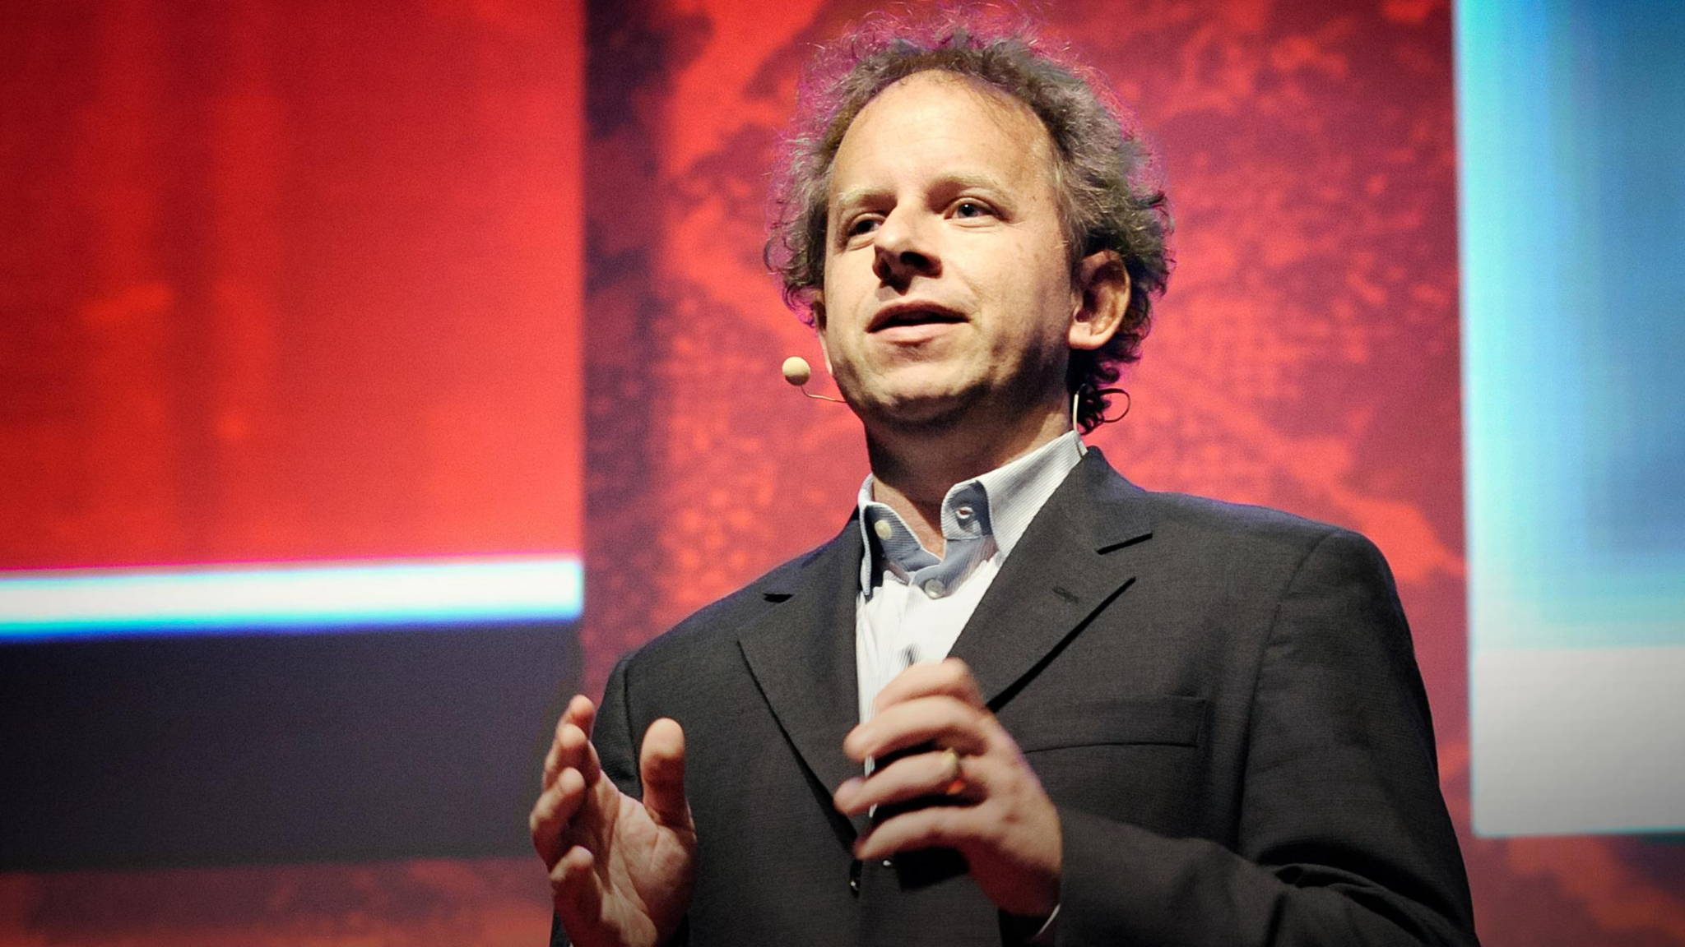
Universal Language Model Fine-tuning [7]
Pretrained language model
Transfer learning
Domain specific language model
Classifier
Better performance
Less data
Notes:
Far right photo citation: Jeremy Howard and Rachel Thomas. https://www.fast.ai/. Making neural nets uncool again. Fast.ai.
Middle photo citation: Jeremy Howard: Will Artificial Intelligence Be The Last Human Invention? Retrieved December 12, 2021 from https://www.bpr.org/post/jeremy-howard-will-super-intelligent-machines-be-last-human-invention
This guy named Jeremy Howard developed a MOOC and a library called fastai. It’s built on top of Pytorch, which is a very high-level library as-is. He also was a professor at University of San Francisco.
Universal Language Model Fine-tuning is a way to perform transfer learning with natural language processing.
Pretrained language model
Huge model
Transfer learning
What even is a language model?
Predicts the next word in a sentence
Needs to know the language very well
Domain specific language model
Remove the last layer on the pretrained language and add a random linear layer
Train on your text corpus
Classifier
Add a layer to the end to perform classification
Train more
Better performance (18%-24%)
Less data (by 100x)

Slide 9
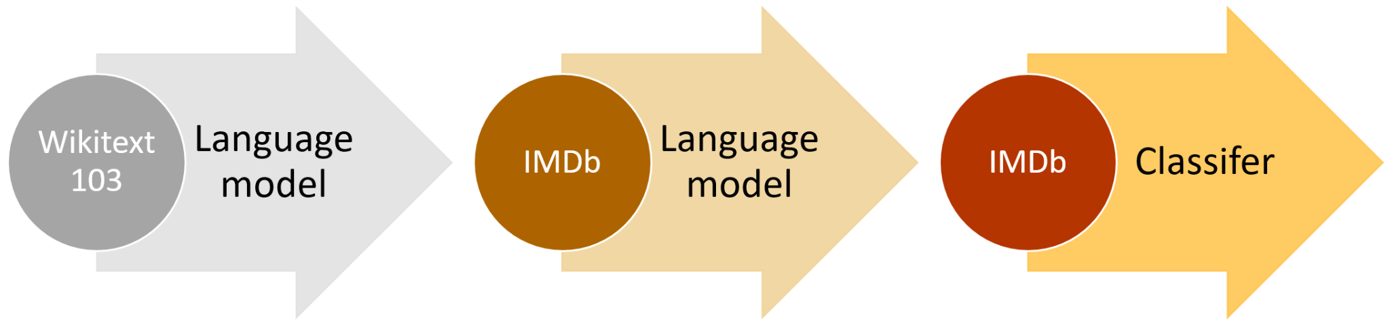
Language Modelling and Text Classification
AWD_LSTM
Wikipedia
Training process
Freezing/unfreezing
Notes:
Photo Citation: Yashu Seth. 2018. Understanding the Working of Universal Language Model Fine Tuning (ULMFiT). Let the Machines Learn. Retrieved December 12, 2021 from https://yashuseth.blog/2018/06/17/understanding-universal-language-model-fine-tuning-ulmfit/
AWD_LSTM
Trained on wikipedia
Knows english basically
The language model used for transfer learning in fastai
Training process
As described in previous slide
Freezing/unfreezing
When you add a layer, freeze updates on all layers except for last one
Then can go top 2 layers, top 3 layers, etc
After a few epochs you can unfreeze the whole model and train all layers

Slide 10
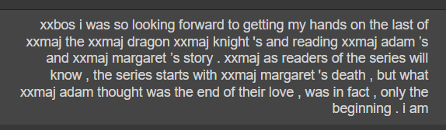
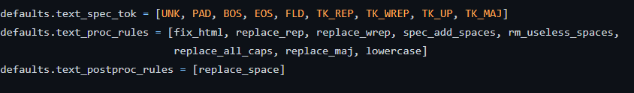
Data Preprocessing
Web scraping errors
Not English
Tokenization
Numericalization
Embedding matrix
Notes:
Web scraping errors
Had to remove NaNs
Not English
Use spacy langdetect
Uses a CNN to guess the language of the text
Did a pretty good job
Dropped from like 80,0000 reviews to 42,000
Tokenization
Turn words into tokens
Vocabulary size of 60, 000
Minimum frequency of a word to be in the vocabulary was 3
Special tokens for capital letters or repeated letters, start of text example, etc
Numericalization
Assign each token a number
Embedding matrix
Matrix of word frequency basically
Used default settings for everything

Slide 11
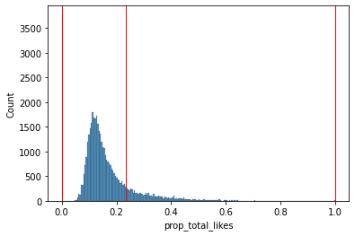
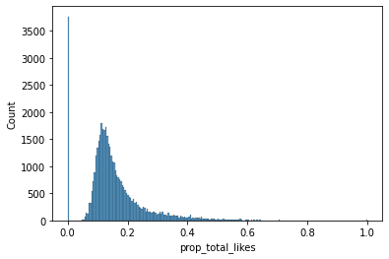
Different meanings of “helpful”
Transformation
Square root
Discretizations
2 quartiles
4 quartiles
KMeans clustering
Histogram binning
Sqrt, KMeans
Notes:
Transformation
The original distribution of prop_total_likes was extremely extremely right skewed so I tried to balance it out a bit with a transformation
Used square root
Couldn’t do boxcox or log because of 0 values in the dataset
This way was cool because it clearly separated reviews with no likes (far left bar)
Much less skewed, but still skewed
Discretizations
Tried many different things
2 quartiles
4 quartiles
KMeans clustering
Silhouette statistic chose 2 clusters as best
Histogram binning
Chose 10

Slide 12
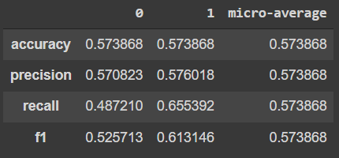
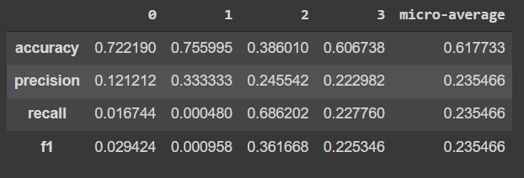
Performance
No sqrt, median
Language Model
31% accuracy
Classification
Poor performance
Sqrt, 4 quartiles
Notes:
Language Model
31% accuracy
Pretty good!
Correctly predicts the next word in a book review 31% of the time
Classification
Poor performance
I don't even know what went wrong
Very surprised
Maybe this task is not suitable for this approach
Not one of the discretizations worked well
You can see a few here
Just taking the median of the raw prop_total_likes data gave 7% more accuracy above chance
The one on the bottom had decent accuracy for the quartiles but awful precision and recall

Slide 13
Conclusion
Need more than just text
Usefulness of ULMFiT
CNN? GRU?
Good language model
Bad classifier
Notes:
Need more than just text
Too optimistic
For this problem the other features (reviewer expertise, time of review) are just too important
One paper did it well, though
Usefulness of ULMFiT
This workflow doesn’t even allow me to input features other than the text
CNN? GRU?
Maybe the LSTM from AWD_LSTM wasn’t great for this problem
Good language model
Worked well
Bad classifier
Obviously did not work well
Thank you for listening!

Slide 14
Citations
[1] to [21] are on the project report bibliography
Each picture is cited in their respective slide’s speaker notes

